Slide 1
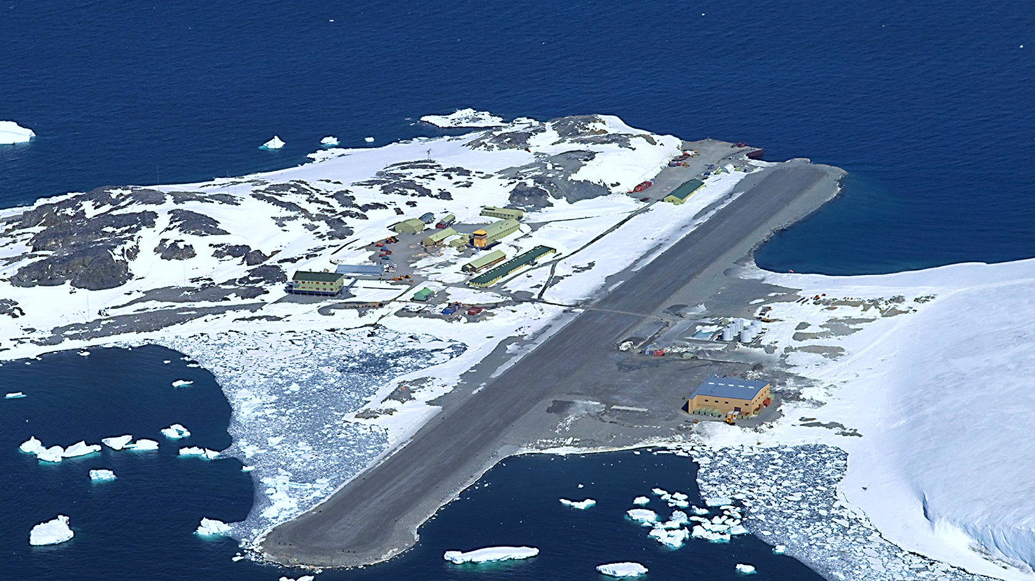
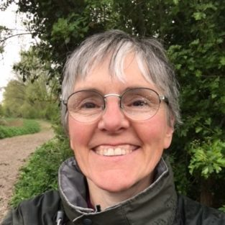
Optimising Remote Field Station Food Purchasing
Sophie Turner
Maria Fox
Notes:
MRes project
Optimising remote field station food purchasing

Slide 2
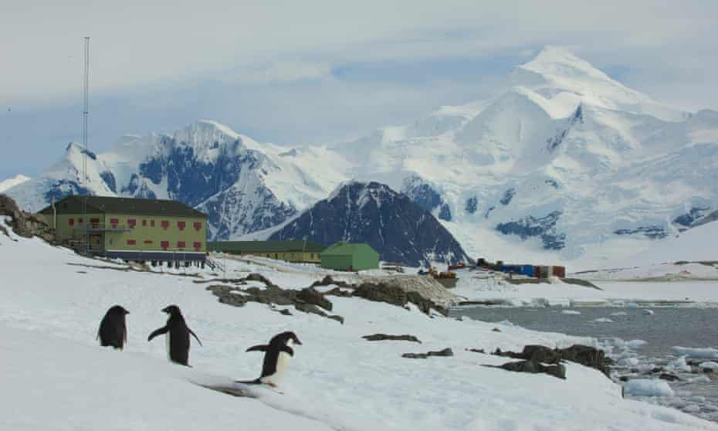

Rothera research station
Notes:
With BAS
Rothera is their largest station.
22 to 170 people year-round.
18 month contracts.
Food brought on SDA yearly.
Operations team.
BAS want to optimize this process.

Slide 3
GWP = global warming potential kg CO₂e
Notes:
Terminology.
Rough average estimates.

Slide 4
The Future of Food in the Antarctic: a report prepared
for the British Antarctic Survey investigating the carbon
intensity of food supplied to an Antarctic research station
Edmund Dickens, 2021, University of Exeter
~ 263,919 kg CO₂e
~ 2 million km
~ 189 cars
Notes:
Last year, Edmund from Exeter worked with BAS on this topic.
He wrote a report on …. title
He estimated the GWP of food brought to Rothera in 2020 to be 264 t.
To get a relatable perspective, this is roughly equivalent to ....
It’s hard to say how accurate this figure is bc lack of data.
I used this as my baseline because it’s the only estimate we have.
I made my own estimate and assumptions without looking at Edmund’s calculations and got a very similar figure to this.

Slide 5
GWP Cost Food waste Packaging waste
Enjoyment
Variety
Nutrition
Allergies
Logistics
Notes:
Cost and waste are unknown. No data.
Minimise, maximise, constrain.
Logistics includes planned schedules for people and vehicles, storage.
Storage needs to be frozen, dried or tinned. There is some fresh food but not reliable.

Slide 6
How to model the problem?
Lack of data
Constraint satisfaction problem
Nutrition Allergies Logistics
Multi-objective optimisation problem
Emissions Cost Food waste Packaging waste Variety
Notes:
Reasoning of operations team.
Almost no data. Spreadsheet of schedules only.
ML not applicable.
NN not applicable.
Define CSP
Explain opt
CSP with optimising obj fn
Human side
How it works

Slide 7
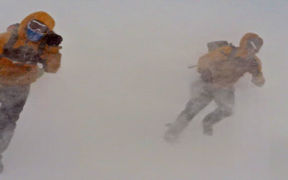
~ 3261
> 4000
Notes:
Hard work. Average calories. Max calories.

Slide 8
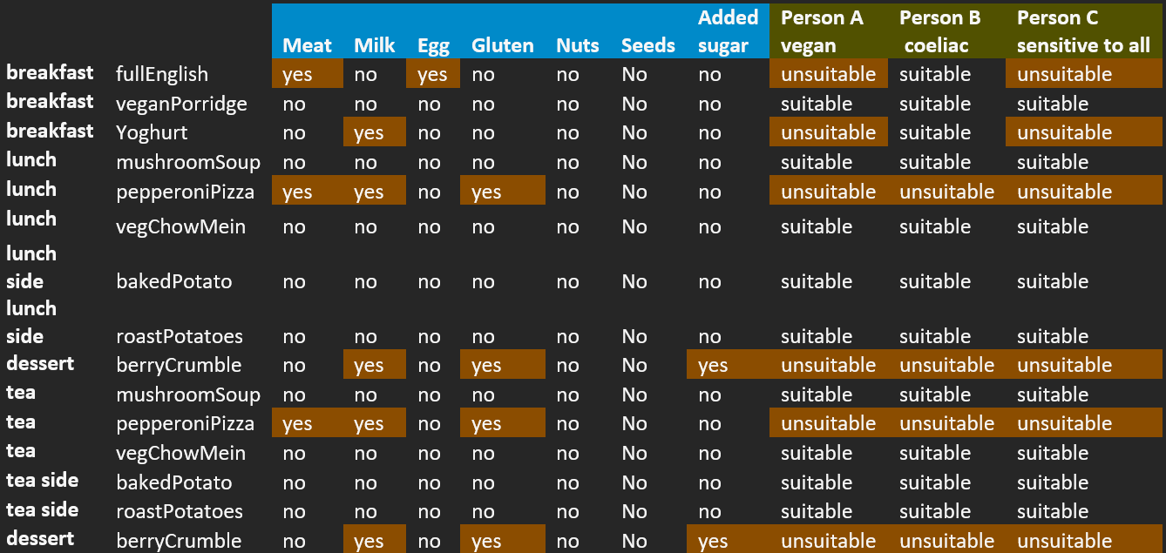
Notes:
Meal options
Allergens
Example people

Slide 9
Notes:
Example meal plan
Explain why the meals are repeated
Side dishes don’t match meals
Computer logic vs human logic
Need to add so many constraints that there is not enough flexibility

Slide 10
Notes:
Explain the axes
Explain the trends of each objective

Slide 11
… and so on …
Notes:
Example shopping list

Slide 12
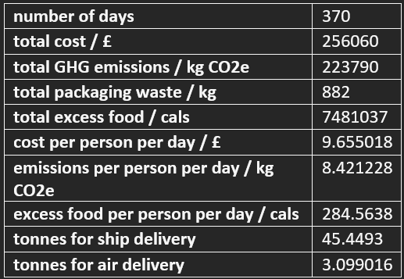
Notes:
Example order summary

Slide 13


≈
316,720 kg CO₂e
263,919 kg CO₂e
221,370 kg CO₂e
~ 2.4 million km
~ 227 cars
~ 2 million km
~ 189 cars
~ 1.68 million km
~ 158 cars
16 %
31 cars
Notes:
Compare unoptimized to optimised bc no real data

Slide 14
Conclusions
AI could help BAS teams to optimise food orders
Potential 16 % reduction of GWP
Gathering more data could help
Humans are important

Slide 15
Thank you
Background picture - National Science Foundation. (2016). Rothera, the British Antarctic Survey station on the Antarctic Peninsula. Available: https://nsf.gov/news/mmg/media/images/Rothera%20station.jpg. Last accessed 5th Jul 2022.
Slide 2 - Bucktrout, P. (2020). Rothera on Adelaide Island. Available: https://www.theguardian.com/world/2020/nov/01/next-stop-antarctica-british-team-covid-free-coronavirus. Last accessed 5th Jul 2022.
Slide 7 - British Antarctic Survey. (2020). Polar fieldwork opportunities. Available: https://www.bas.ac.uk/science/opportunities-for-polar-fieldwork/. Last accessed 6th Jul 2022.
Any questions?

